Slide 1
ORGANIC RICE INDUSTRY in the PHILIPPINES
Situation, Initiatives & Policy in Support to Organic Rice Industry

Slide 2
Organic Rice Industry updated 3/1/12 Total number of arable lands (has): 4.8 M Rice Area : (has) 4.27 M as of 2007
Province | Number of farmers | Number of hectares
Abra | 15 | 20
Aurora* | 20 | 5
Bicol (pakisama)* | 130 | 130
Camarines Sur | 217 | 223
Catanduanes | 40 | 8
Ifugao | 30,000 | 10,000
Isabela* | 20 | 6
Mindoro* | 25 | 37
Quezon | 33 | 8
Nueva Ecija | 620 | 328
Pangasinan | 25 | 12
Sorsogon | 90 | 42
Tarlac | 37 | 60
Bohol | 50 | 30
Guimaras | 56 | 60
Iloilo | 370 | 439
Negros Occidental | 264 | 130
Agusan del Sur | 141 | 135
Agusan del Sur (talacogon)* | 60 | 60
Bukidnon | 105 | 87
Davao del Norte | 200 | 45
Davao del Sur | 182 | 327
Davao Oriental | 18 | 5
Misamis Oriental | 15 | 15
North Cotabato | 4,090 | 2,069
South Cotabato | 91 | 95
Zamboanga del Sur | 50 | 400
Total Philippines | 37,064 | 14,776

Slide 3
Key issues and problems
Drop in yield during conversion
Limited support to organic production (organic seeds, fertilizer, technology, pre and post harvest facilities, seed banks, demo farms, R&D)
Production financing
Only handful of organizations into marketing

Slide 4
Key issues and problems
Organic rice still production driven than market driven
Market capitalization
Certification

Slide 5
Key issues and problems
On policy, needs to be vigilant on the implementation of OA Program
Limited studies about OA initiatives
Capability building for farmers and DA extension workers

Slide 6
Global issues impacting organic rice farming
Land rights
One of the fundamentals of organic farming is the ideals of land stewardship in order to keep the land production for generations
CARP/CARPER (ends by 2014) needs to secure land for farmers
Organic rice production is partly influenced by farmers

Slide 7
Global issues impacting organic rice farming
Climate change
Complex and unpredictable changes in weather patterns: extreme heat and rainfall
Change in rainfall pattern: usual season no longer suitable for the crop
Increase temperature
Increase the frequency of typhoons and dry spell
Rise in sea levels

Slide 8
Impact of climate change
Climatic Events | Impact
Rainfall | Decrease by 20 percent, but increase in intensity. Increase risk of soil erosion and occurrence of landslides.
Rainy days | Decrease rainy days but intensity will be higher than normal, growing periods may shorten by approximately 30 days
Cyclone | Increase intensity and occurrence and may trigger landslides and flooding of coastal areas
Maximum temperature | Increase by three percent, more frequent and persistent El Niño episodes, and increased evaporation. Crop duration shortened between one and four weeks. Drought will be longer and more intense, heat waves occurrence
Flooding | Increase flooding depth, frequency, intensity, and severe landslides. Submergence of coastal communities and coastal erosion
Ground Water Potential | Decrease water availability, poor quality, and salt intrusion
Humidity | Upward trend, can alter geographic distribution of pest and diseases
Cloudiness | Increase in total cloud cover, decrease photosynthesis. Clouds regulate the amount of sunlight received by the surface and so influence evaporation from the surface, which in turn influences cloud formation

Slide 9
Global issues impacting organic rice farming
Price volatility
Changes in food price is sudden
Hunger
Limited reserve

Slide 10
Global issues impacting organic rice farming
Trade liberalization
Calls for the reduction of tariff between 0-5%
Flooding of imported products
Farmers will no longer competitive

Slide 11
Government policies and programs
PNS adopted in 2003
Administrative Order 13, series of 2003-accreditation of certification bodies
PDAP forwarded the National Standards on Organic Rice Production and Processing (2004)

Slide 12
Government policies and programs
Phil National Organic Agriculture Board (Admin Order 1, s 2005)
EO 481 Promotion and Development of OA in the PH
LGU-Valencia City Organic Rice Development Plan; Surallah as Organic Rice Capital, Baras as first organic capital of the Philippines

Slide 13
Government policies and programs
Passage of Organic Agriculture Code in several Provinces/Municipalities (Davao del Norte, Davao City, Bukidnon, Negros Island)
RA 10068 Organic Agriculture Law-increase 5% of the agri-land of PH for organic farming

Slide 14
Government Policies and Programs
Pre and post harvest facilities-tillers, threshers, rice mills for organic farms
Production capital
Farm to market roads development
Seeds and seed banks

Slide 15
Opportunities in organic rice farming
Converting 5% of PHL agri lands needs considerable fund and human resources
NGOs and organic rice farmers as service providers for capacity building of government extension workers and farmers
Input providers-Organic rice and fertilizer

Slide 16
Opportunities in organic rice farming
Converting 5% of PHL agri lands needs considerable fund and human resources
Demo farms for high yielding varieties and technology
Farm equipment and post harvest facilities (power tillers, threshers, solar/mechanical dryers, warehouse, hauling trucks, etc)
Irrigation
Trading capital
Inbound logistics

Slide 17
Opportunities in organic rice farming
Processing
Working capital
Rice mills (with colour sorter) to ensure integrity of organic products
Ware house/packing house
Processing equipment and materials (digital weighing scale, moisture meter, bag closer, vacuum sealer, plastics, sacks)
Outbound logistics

Slide 18
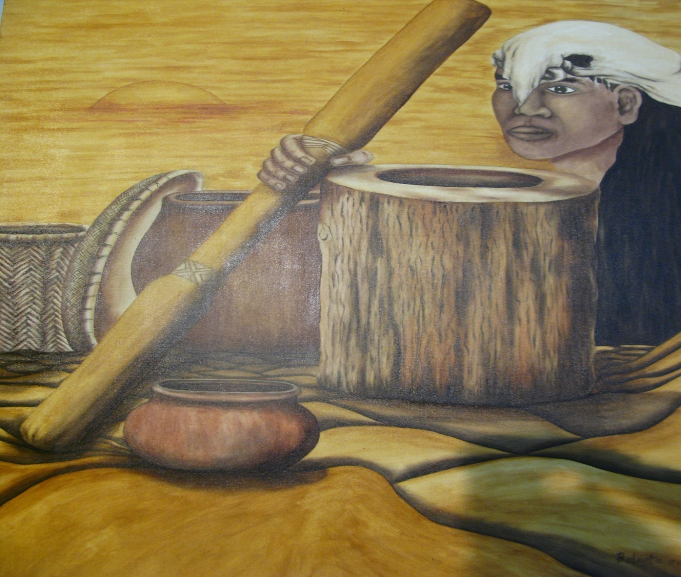
Thank you for your time

